Slide 1


TravelTide Customer Retention Mastery Project
Data-Driven Segmentation & Optimal Perk Assignment Strategy
MasterSchool Project | May 2025 | Hande Gabrali-Knobloch | 28.11.2025

Slide 2
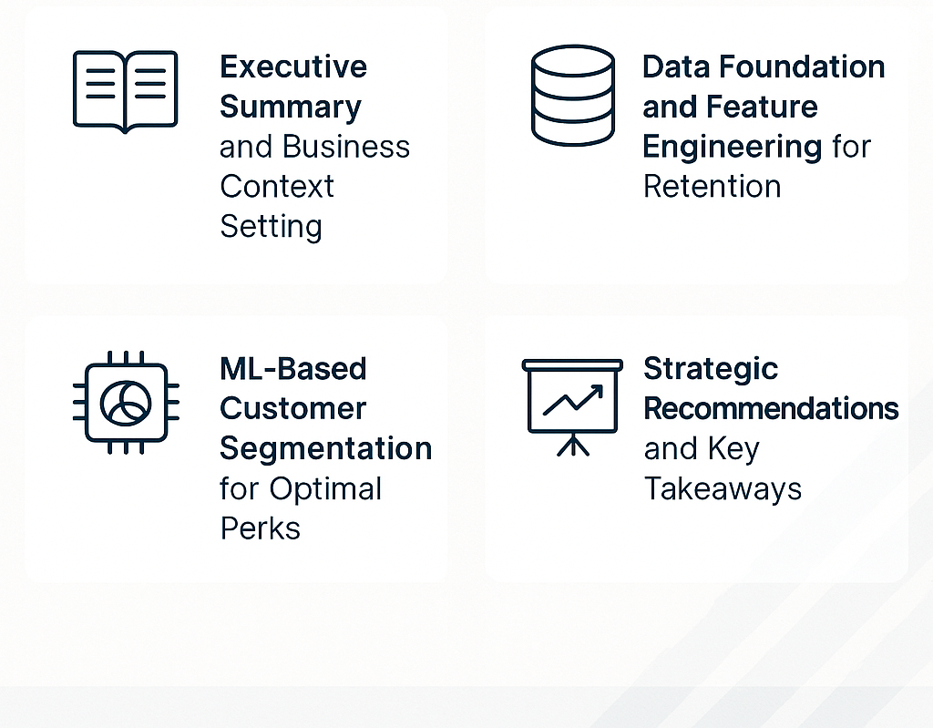
Agenda

Slide 3
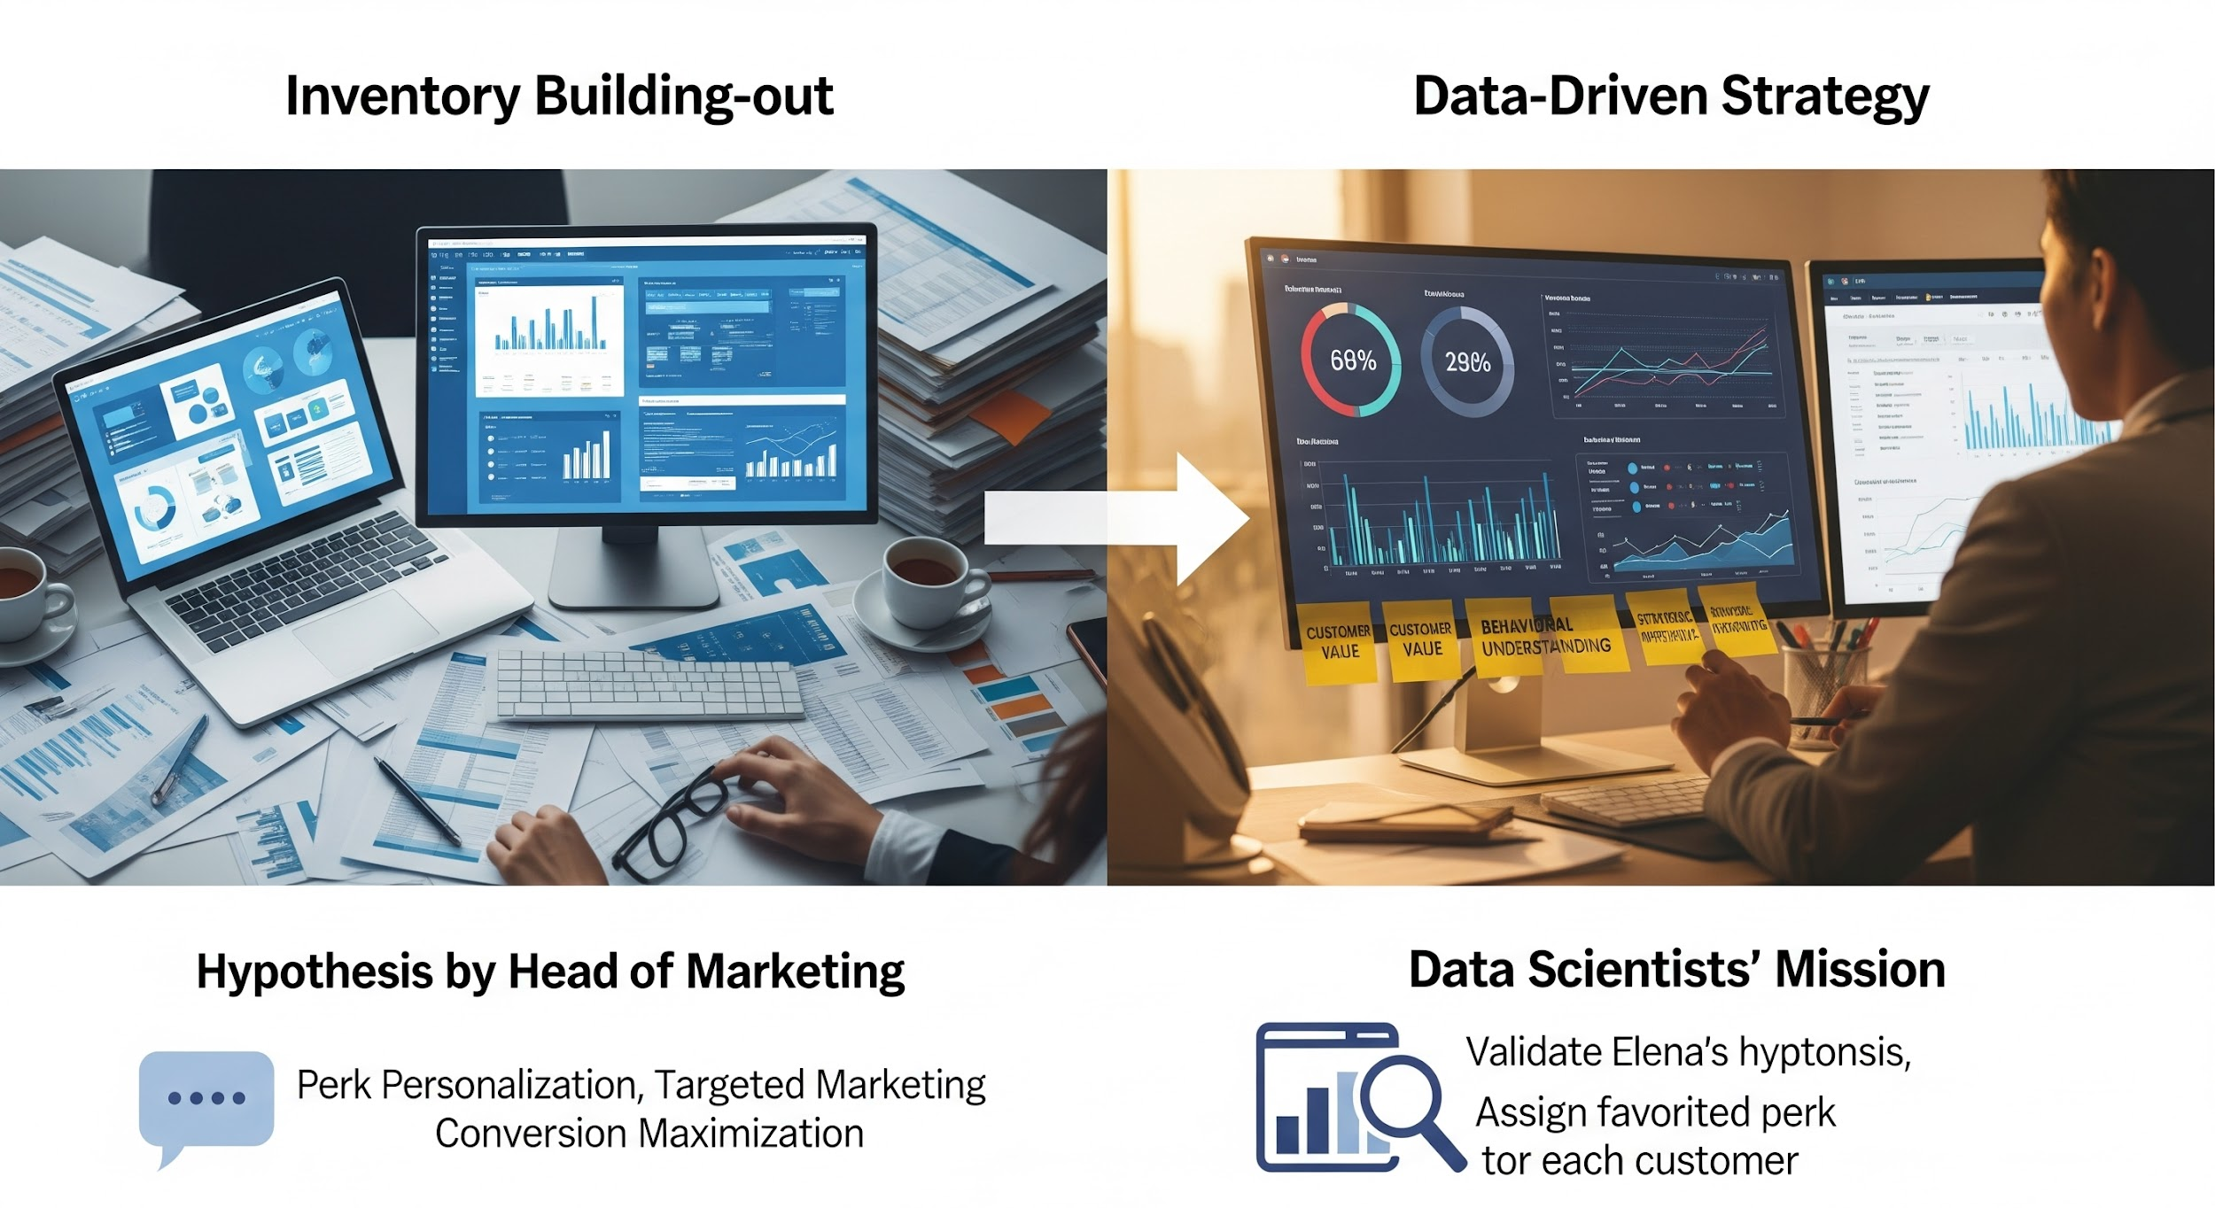
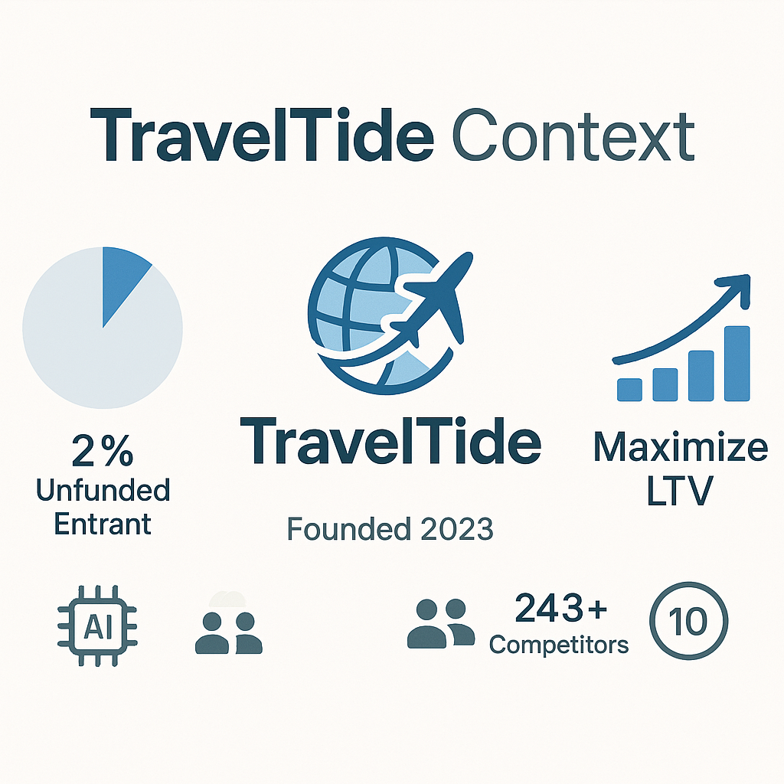
Executive Summary & Business Context Setting
Vestibulum congue tempus
Notes:
Positioning: An agile, unfunded entrant founded in 2023.
Core Tech: AI-powered travel itinerary creator.
Critical Issue: Poor customer retention scores (10/100 benchmark).

Slide 4






Data Foundation and Feature Engineering for Retention
Dataset
Segments
Features
Analysis of 49,000+ user sessions from the 2023 cohort (users with >7 sessions).
Cohorts filtered for high-intent behavior to isolate meaningful retention signals.
Engineered features: cancellation_rate, total_spend, session_clicks.

Slide 5
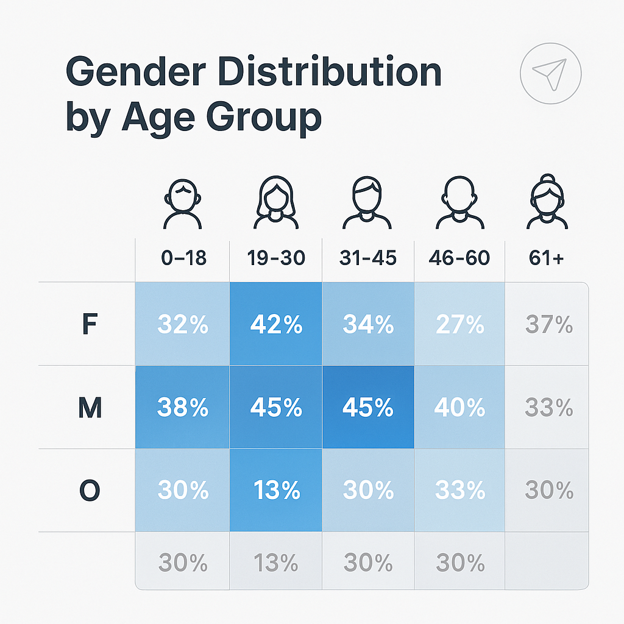
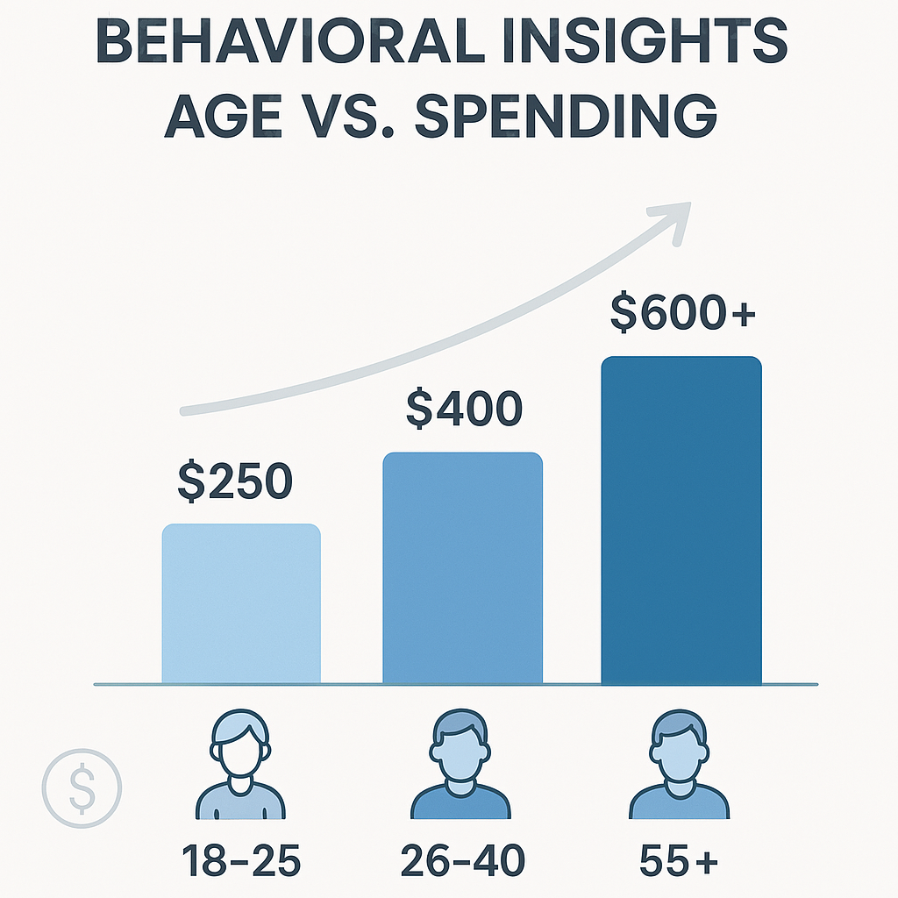
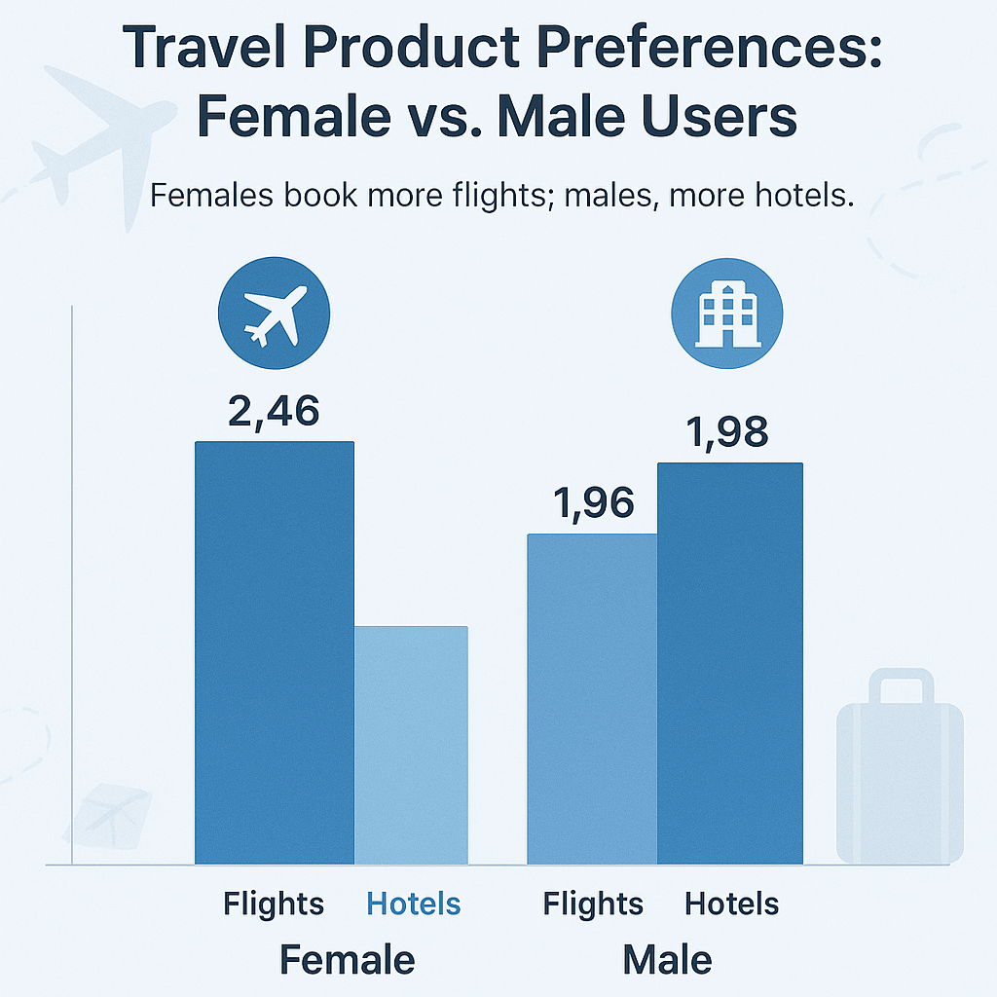
Gender, Age vs. Spending
Pearson r = 0.58 (Moderate Positive)
Insight: Customer spending power grows significantly with age, peaking in the 55+ group. Females book more flights; males, more hotels.
Notes:
Females receive/utilize a 27.6% higher average discount on Flights, while Males receive a 21.4% higher average discount on Hotels.

Slide 6
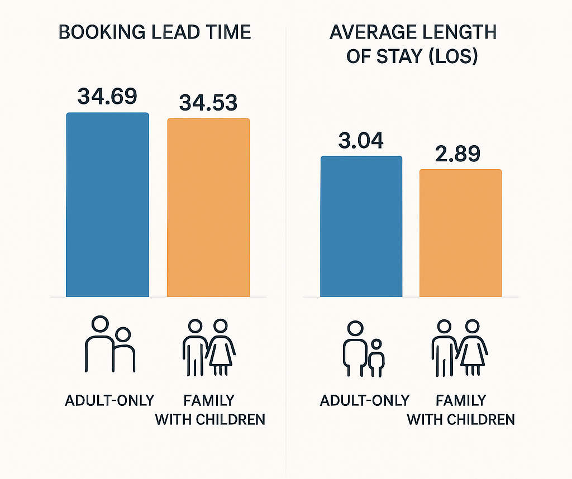
Family vs. Adult-Only Cohorts Insights
Insight: Identical Lead Time (~34.5 days), Family Retention Gap (Lower LOS), Opportunity: 'Extended Stay' Incentives.
Notes:
(Descriptive & Analytical - Betimleyici ve Analitik): "The comparative cohort analysis reveals a strict behavioral parity in Booking Lead Time (<0.16 days variance), indicating that family status does not influence planning horizons. However, a divergence exists in consumption, where the Family cohort slightly underperforms in Average Length of Stay (2.89 days) compared to the Adult-Only segment (3.04 days).“
(Strategic Focus - Strateji Odaklı): "While customer acquisition timelines are identical across segments (Lead Time ~34.5 days), the data highlights a retention gap in the Family market. The lower Length of Stay for families suggests a need for targeted 'extended stay' incentives, as the current product offering appears optimized for shorter duration family trips.“
(Short & Punchy - Kısa ve Öz): "Family demographics show zero correlation with booking earliness but act as a negative driver for duration, with Adult-Only itineraries consistently outlasting Family stays despite identical planning windows."

Slide 7
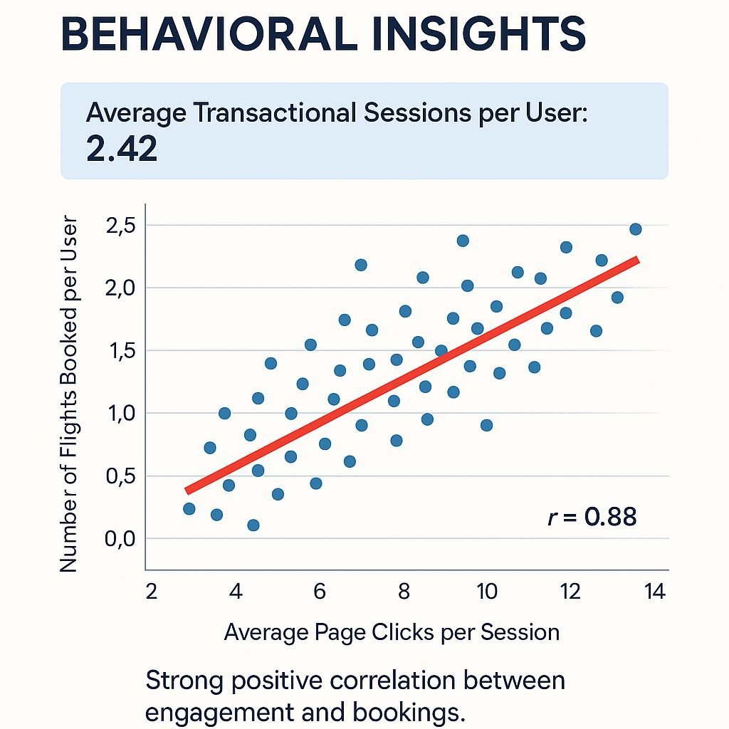
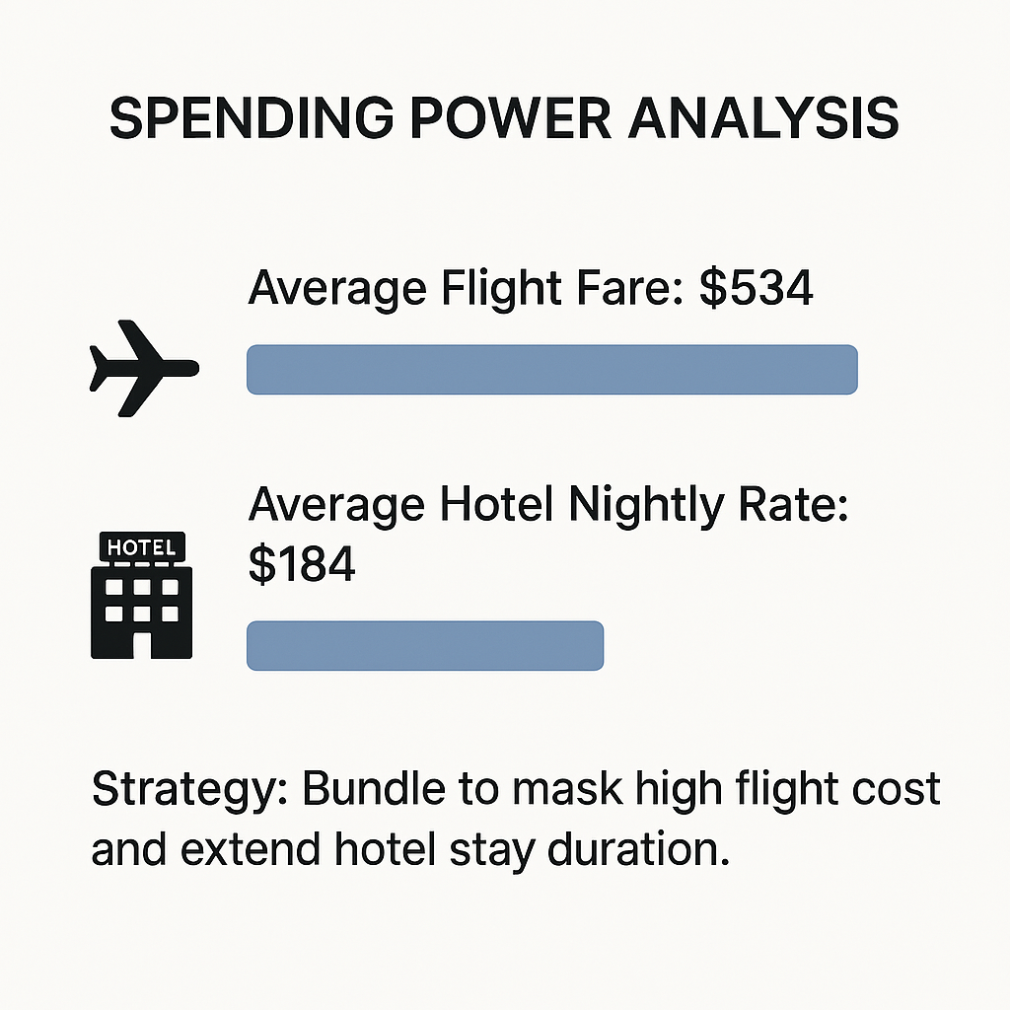
Exploratory Analysis of Behavioral & Transactional Features
Insight: Flight costs are 3x higher than nightly hotel rates. Strategy must focus on bundling to mask the high flight cost and extend hotel stay duration.

Slide 8
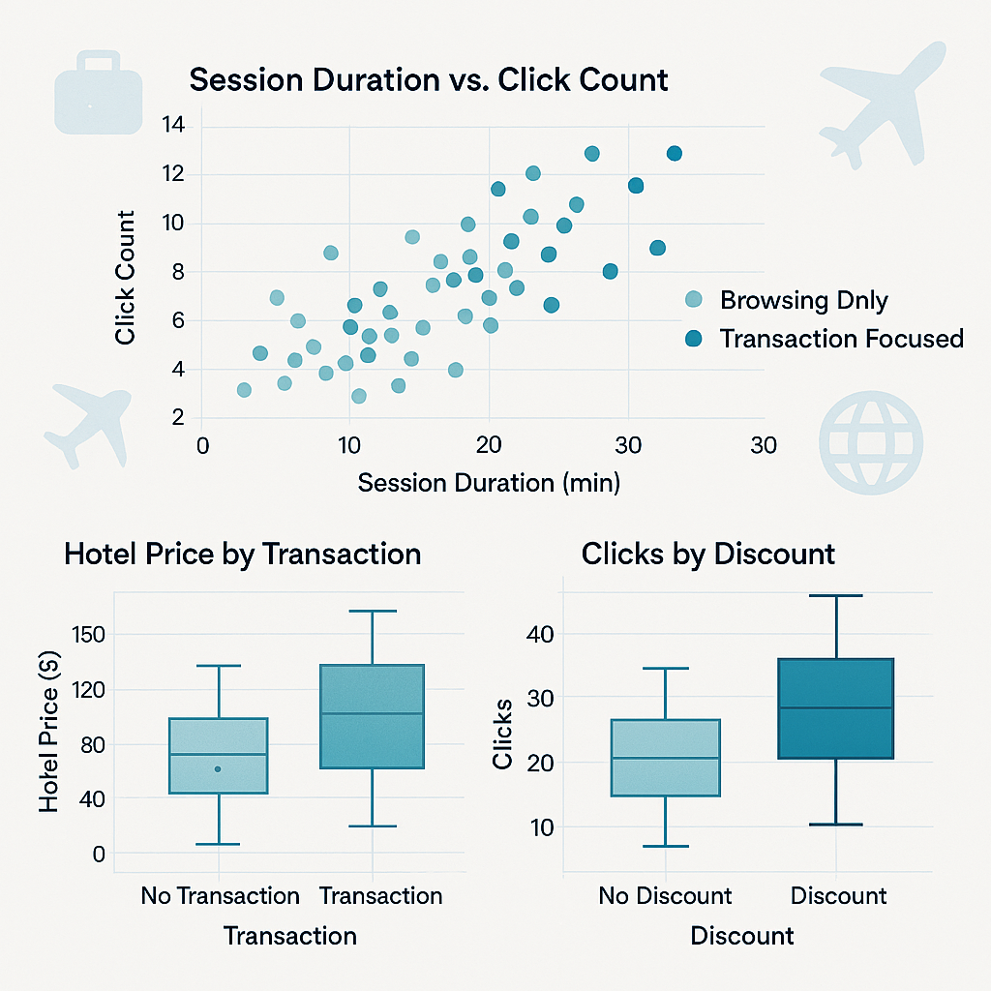
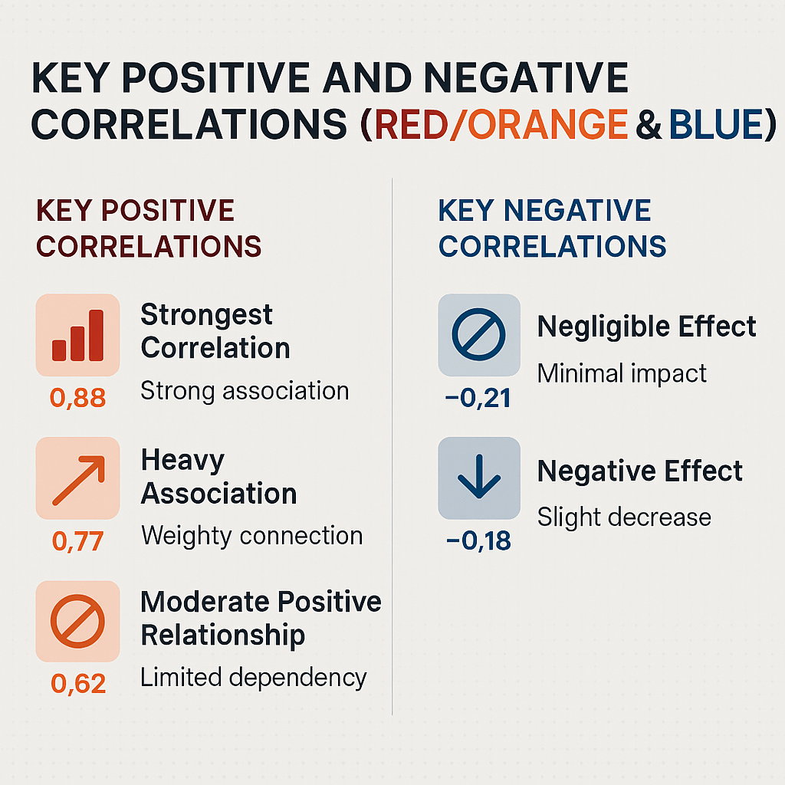
Exploratory Analysis of Behavioral & Transactional Features
Insight: The data indicates strong predictive power on the positive spectrum with coefficients reaching 0.88, while negative correlations remain below the threshold of significance (max -0.21), having minimal impact on the overall model.
Insight: Log-transformed metrics indicate that high session duration and click
frequency are primary determinants of transactional status, clearly distinguishing buyers from casual browsers.

Slide 9
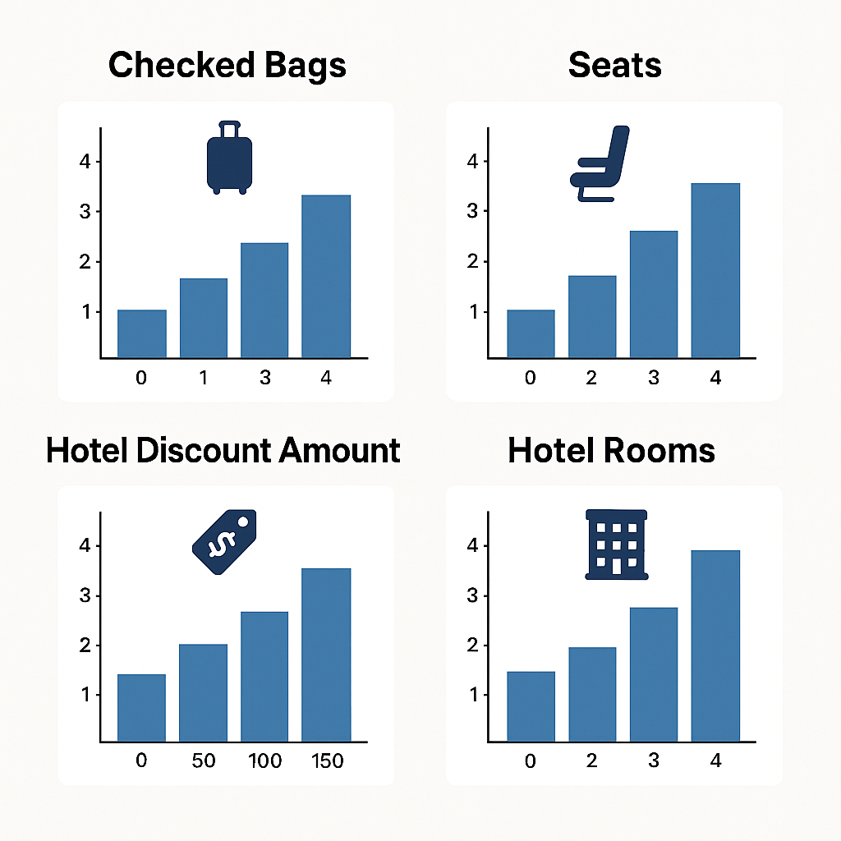
Customer Preferences & Booking Trends
Insight:
(Rooms): Single-Occupancy Dominance & Outlier Multi-Room Bookings
(Checked Bags): Bimodal Preference & Business vs. Leisure Split
(Hotel Discount Amount): Discrete / Tiered Pricing & Standardized Intervals
(Seats): Rare Group Travel
Notes:
Insight:
(Rooms): The extreme density at a single room count indicates that multi-room bookings are statistical outliers, confirming a single-occupancy dominant user behavior.
(Checked Bags): The distribution reveals a clear split in user preference, with the majority checking either zero or one bag, suggesting a dichotomy between light business travelers and standard leisure passengers.
(Hotel Discount Amount): The multimodal distribution with discrete peaks at 0.05 intervals suggests that discounts are applied via standardized promotional tiers rather than dynamic, continuous pricing algorithms.
(Seats): Similar to room bookings, the seat count feature is strictly right-skewed, identifying group travel (2+ seats) as a rarity that may require a separate segmentation strategy.

Slide 10
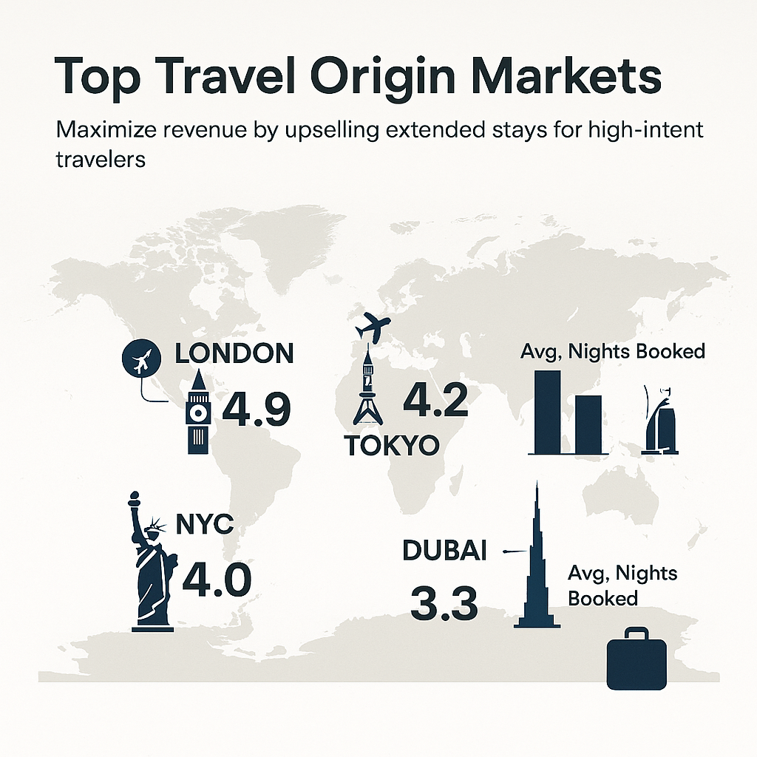
Top Origin Markets
Insight: Maximize revenue by upselling extended stays to high-intent travelers in London and Tokyo, while prioritizing convenience for the high-frequency Dubai market.

Slide 11
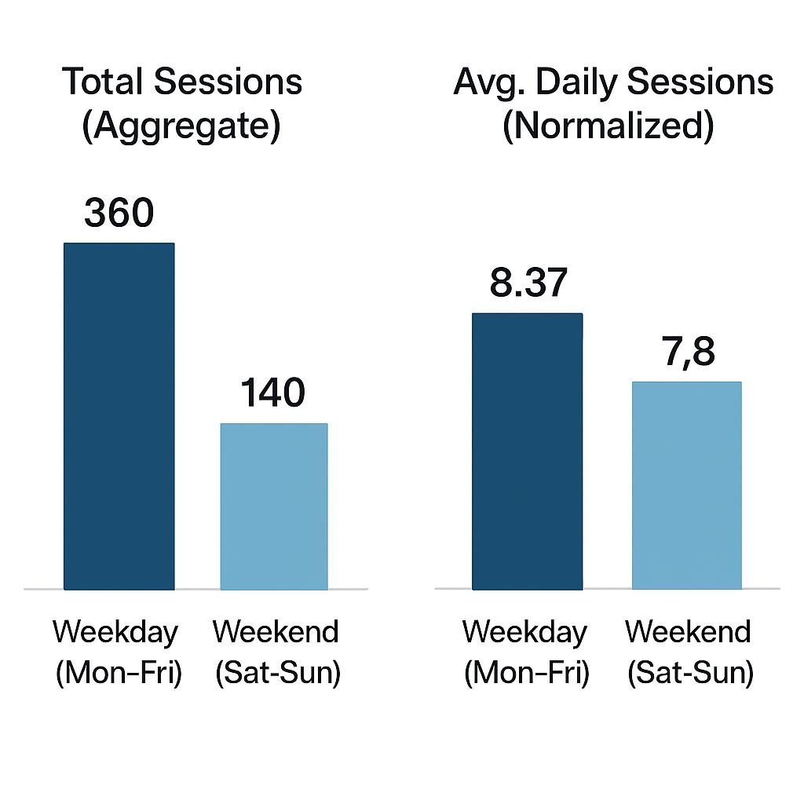
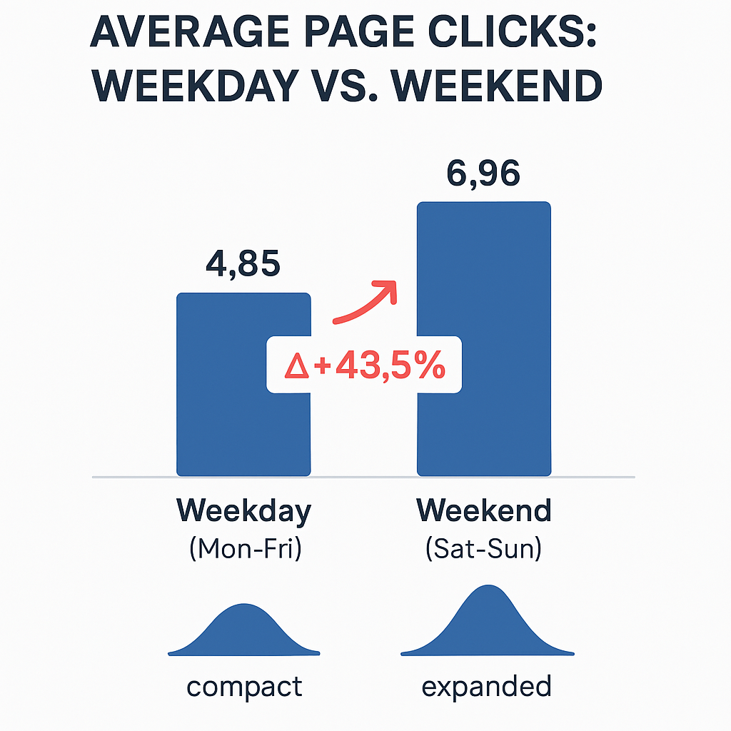
Temporal Behavioral Analysis:
The Weekend Anomaly
Insight: Weekends represent a period of High Spend and High Conversion, but also significantly Higher Volatility.
Notes:
"Weekend users demonstrate considerably higher intent, driving average page clicks from 4.85 to 6.96 (+43.5% Delta), proving that Saturday and Sunday are the peak windows for deep interaction.“
(Comparative - Karşılaştırmalı ve En Güçlüsü): "While both verticals benefit from the weekend effect, Flights significantly outperform Hotels, registering a massive +30.7% relative lift in conversion compared to the +19.7% growth in accommodation bookings."
Option 2 (Performance Focus - Performans Odaklı): "The weekend surge drives double-digit growth across the board, with Flight conversion rates peaking at 21.43%, showing a much stronger elasticity to weekend demand than Hotels."
Option 3 (Short & Punchy - Kısa Özet): "Flights lead the weekend rally with a 30.7% spike in conversion growth, significantly outpacing the 19.7% lift observed in the Hotel sector."

Slide 12
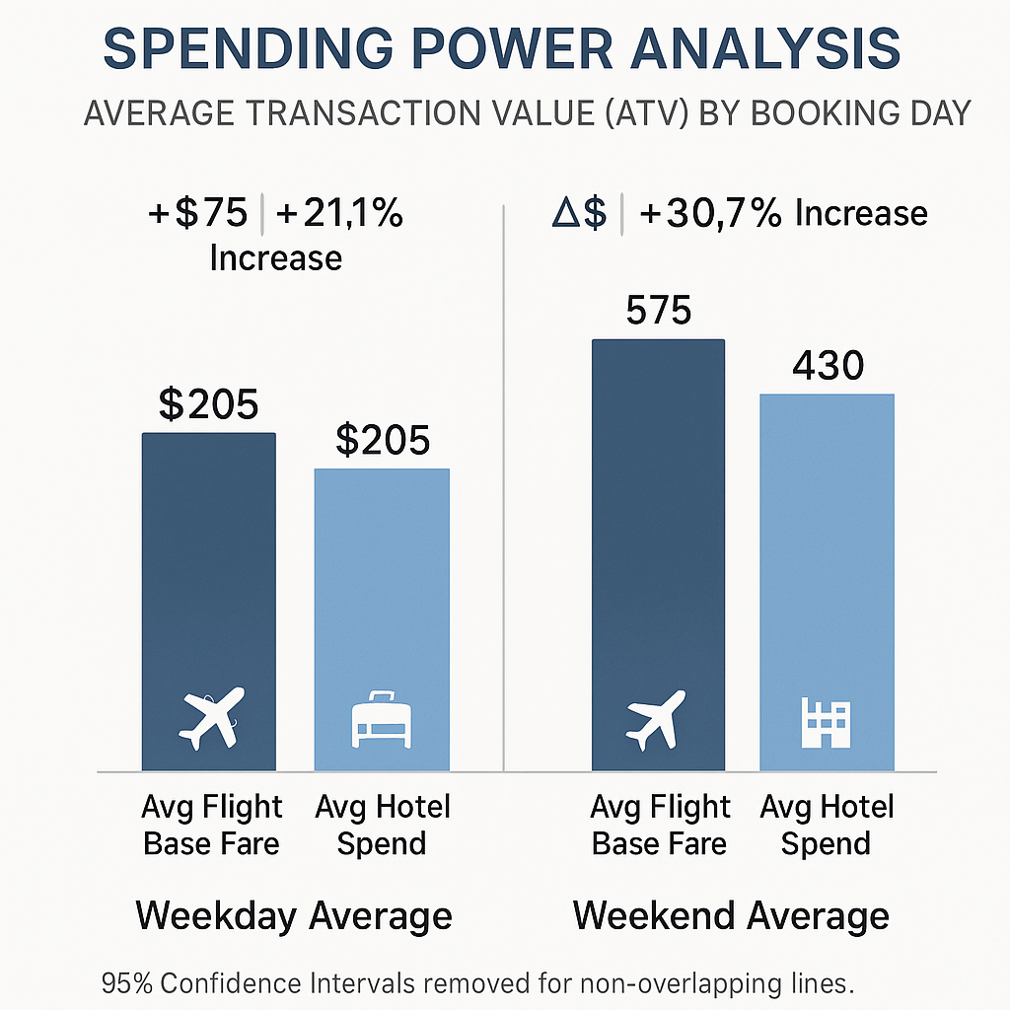
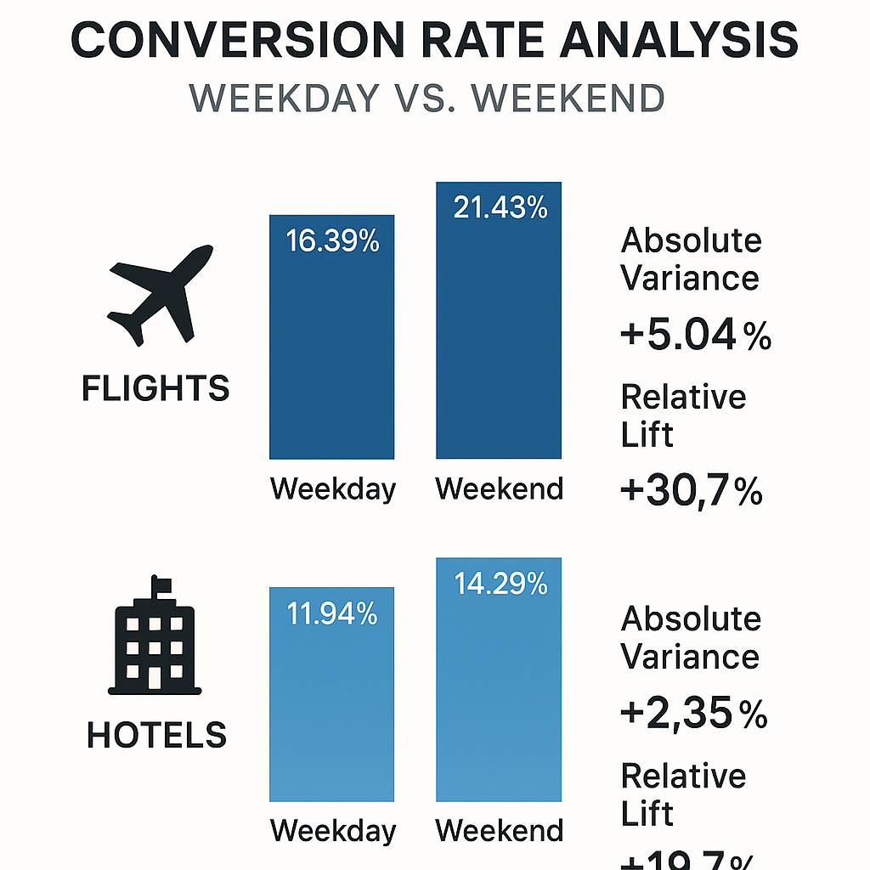
Temporal Behavioral Analysis:
The Weekend Anomaly
Insight: Flights lead the weekend rally with a 30.7% spike in conversion growth, significantly outpacing the 19.7% lift observed in the Hotel sector.
Notes:
Option 1 (The "High-Risk, High-Reward" Insight - En İyisi): "Weekend traffic presents a classic 'High-Risk, High-Reward' scenario. While Average Transaction Value (ATV) skyrockets (Flights hit $575), this premium segment is significantly more volatile, with cancellation rates surging to 15.00% compared to just 9.44% on weekdays."
Option 2 (Behavioral Focus - Davranış Odaklı): "The data indicates that weekend users are high-spenders but less committed. Despite willing to pay nearly 3x more for flights ($575 vs $205), they exhibit a ~60% higher probability of cancellation, suggesting impulsive booking behavior."
Option 3 (Short & Punchy - Özet): "Weekend bookings drive maximum revenue per user (Flight ATV: $575) but suffer from a 15% cancellation rate, creating a critical trade-off between higher basket size and lower retention stability."

Slide 13
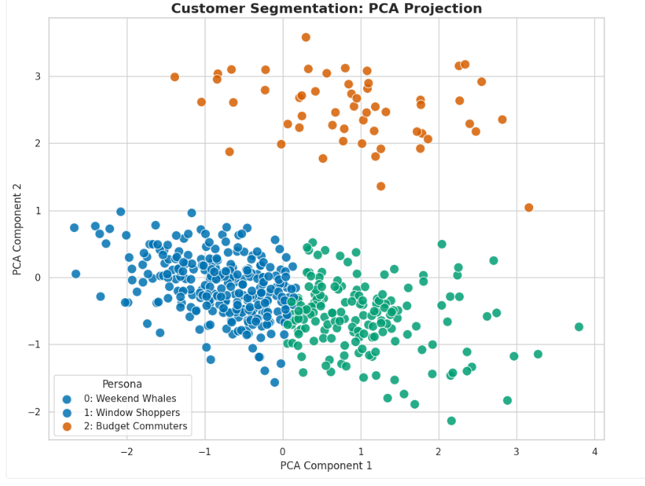
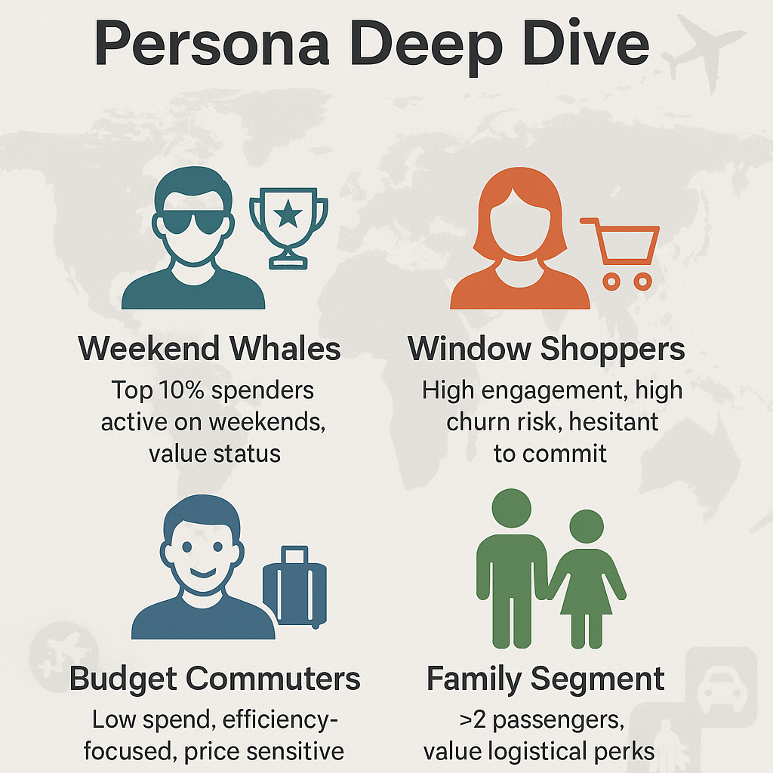
ML-Based Customer Segmentation for Optimal Perks
Insight: PCA-Validated Segmentation: "Weekend Whales" isolated as high-value outliers vs. dense mass market volume Strategic Split: Exclusive non-price retention for elite users; price sensitivity drives Shoppers & Commuters.
Notes:
(Technical & Analytical - Teknik ve Analitik): "The PCA projection validates the distinct clustering of our user base, clearly isolating high-value 'Weekend Whales' (Orange) as statistical outliers compared to the dense, high-volume cluster of 'Window Shoppers' (Blue). This confirms that top-tier spending behavior is fundamentally distinct from general engagement."
Option 2 (Strategic Focus - Strateji Odaklı): "While 'Window Shoppers' represent the bulk of the volume (Blue cluster), their behavioral proximity to 'Budget Commuters' suggests a high sensitivity to price. In contrast, the spatial separation of 'Weekend Whales' indicates a need for a completely exclusive, non-price-driven retention strategy."
Option 3 (Short & Punchy - Kısa Özet): "The data reveals a clear behavioral divide: 'Weekend Whales' form a distinct, high-value island, while the mass market is split between hesitant 'Window Shoppers' and efficiency-focused 'Budget Commuters'."

Slide 14
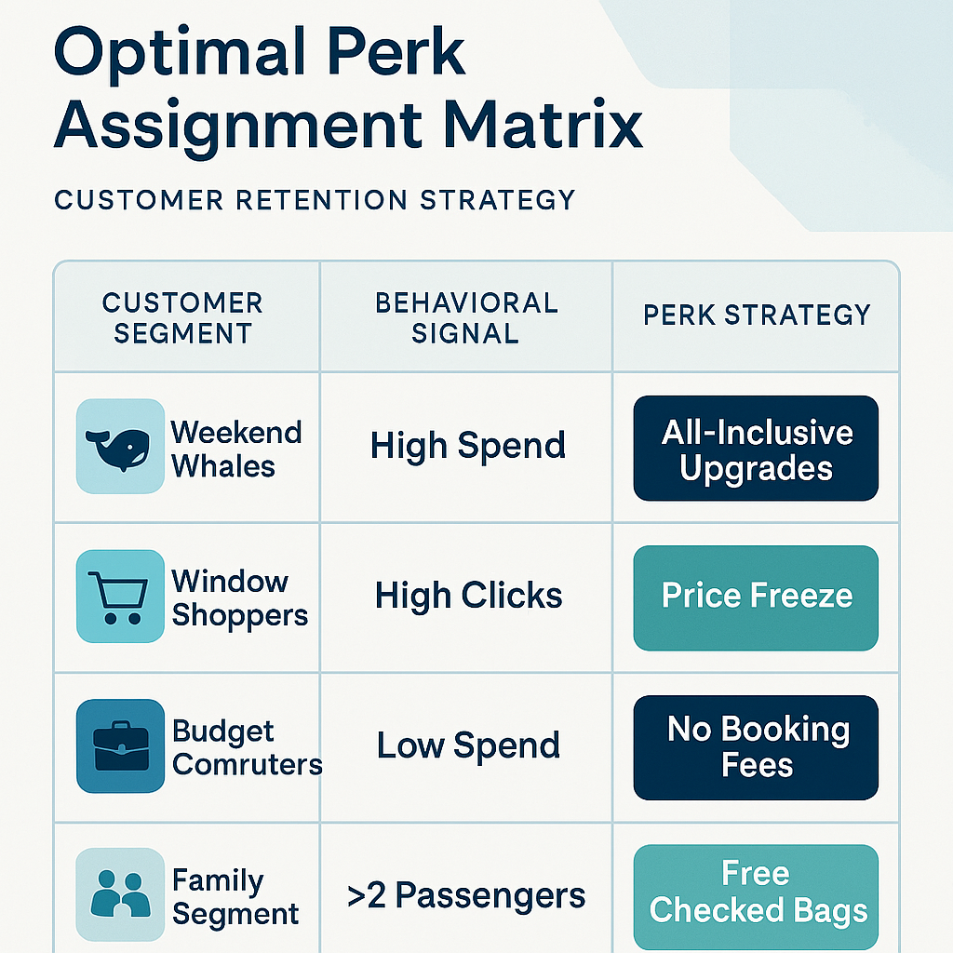
Optimal Perk Assignment Matrix
Insight: This approach monetizes Status for high spenders, ensures Certainty for hesitant browsers, and solves Logistical pain points for families.
Notes:
Option 1 (Strategic Alignment - En Stratejik): "The matrix shifts from generic discounting to 'Behavioral Friction reduction'. By offering Status to Whales (Upgrades) and Certainty to hesitant Window Shoppers (Price Freeze), the strategy aligns incentives directly with the primary psychological driver of each segment."
Option 2 (Action/Conversion Focus - Aksiyon Odaklı): "Retention is optimized by addressing specific pain points: 'Price Freeze' converts high-intent browsers by removing volatility risk, while 'Free Checked Bags' targets the logistical burden of the Family segment rather than just price."
Option 3 (Short & Punchy - Kısa Özet): "Perk assignment is strictly persona-driven: We monetize 'Status' for High Spenders (Upgrades) while solving 'Logistics' for Families and 'Cost' for Budget Commuters."

Slide 15
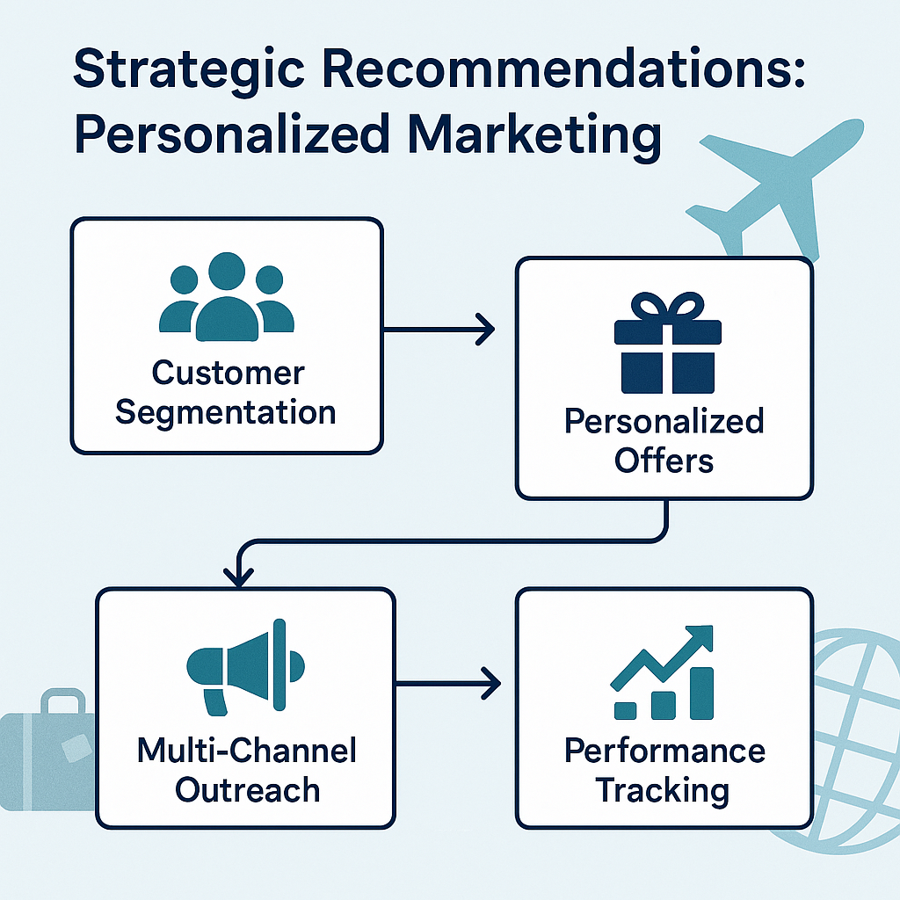
Strategic Recommendations: Personalized Marketing
Insight: Success lies in operationalizing data: Turning Segmentation into Action (Offers/Outreach) and Action into Intelligence (Performance Tracking).
Notes:
Option 1 (Process Flow - Süreç Odaklı): "The framework illustrates a closed-loop marketing ecosystem, where Customer Segmentation dictates the specific Personalized Offer, ensuring that every Multi-Channel interaction is data-backed and validated through rigorous Performance Tracking."
Option 2 (Strategic Value - Değer Odaklı): "Effective personalization is not just about targeting; it is a structured pipeline that converts static Segmentation insights into measurable revenue through executed Offers and continuous Performance Tracking."
Option 3 (Short & Punchy - Kısa Özet): "Success lies in operationalizing data: Turning Segmentation into Action (Offers/Outreach) and Action into Intelligence (Performance Tracking)."

Slide 16
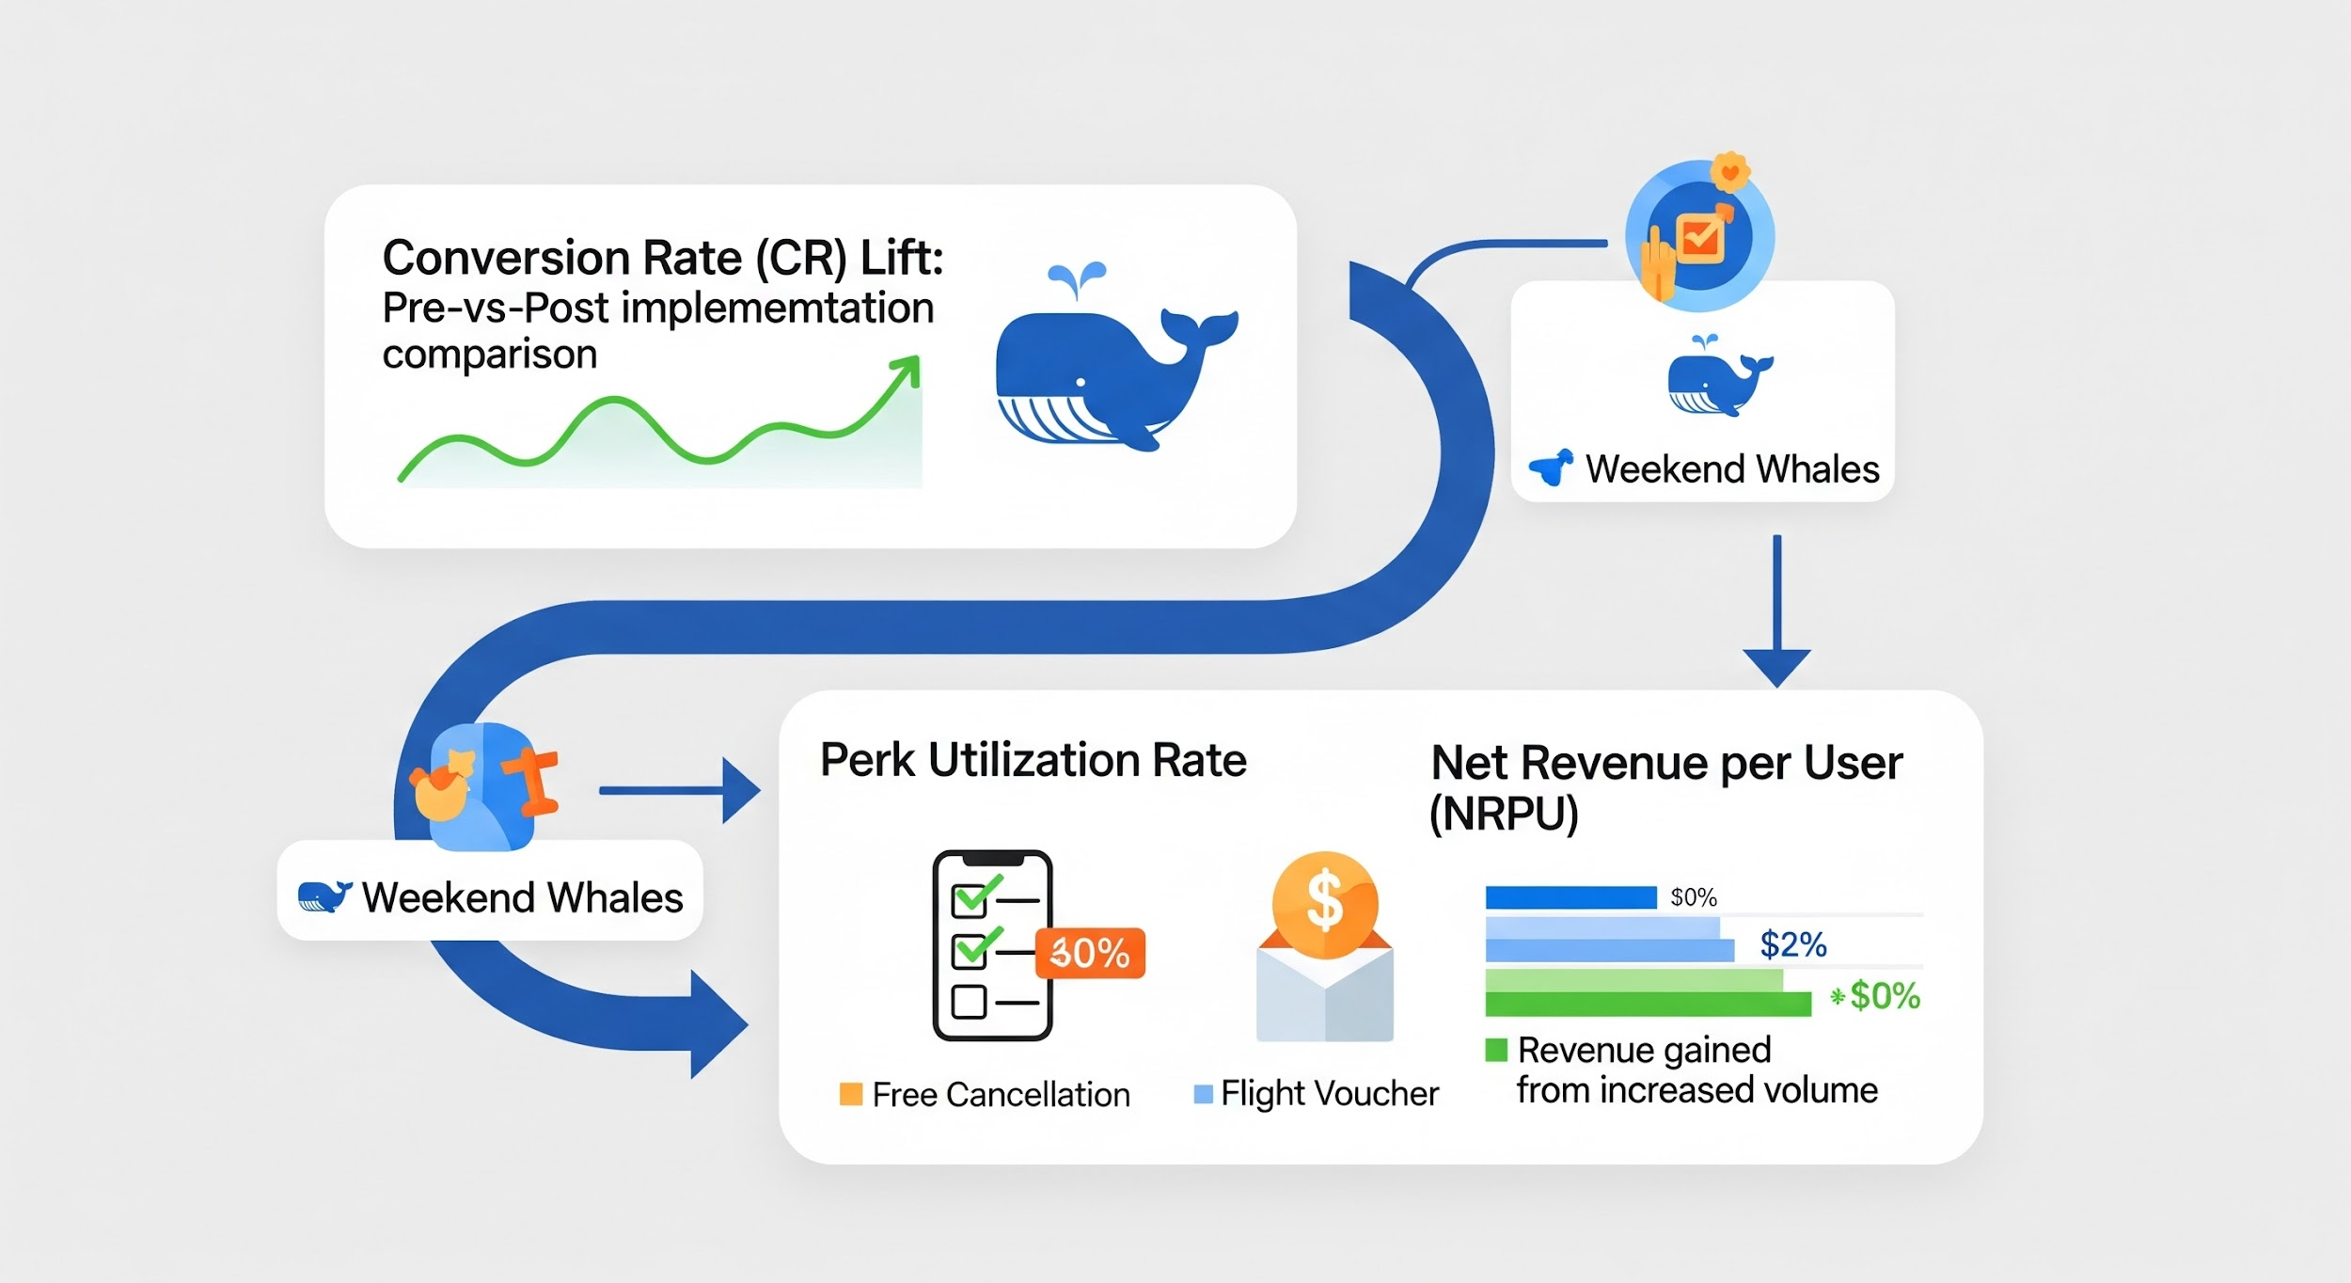
Strategic Recommendations: Success Metrics (KPIs)
Insight: The 30% uptake in 'Free Cancellation' boosted conversion confidence, generating a volume surge that outweighed incentive costs and delivered positive Net Revenue growth.
Notes:
Option 1 (ROI & Impact Focus - Yatırım Getirisi Odaklı): "The post-implementation analysis confirms a positive ROI: High perk utilization (30% for Free Cancellation) drove a significant Conversion Rate Lift, where the resulting volume surge successfully compounded into net revenue growth."
Option 2 (Strategic Driver - Stratejik Odaklı): "By removing booking friction through 'Free Cancellation' (30% uptake), the strategy successfully unlocked the 'Weekend Whale' segment, translating higher conversion confidence into tangible Net Revenue per User (NRPU) gains."
Option 3 (Short & Punchy - Kısa Özet): "The initiative successfully monetized the 'Weekend Whales' segment: A 30% perk utilization rate catalyzed a conversion spike, resulting in net revenue growth driven primarily by increased transaction volume."

Slide 17
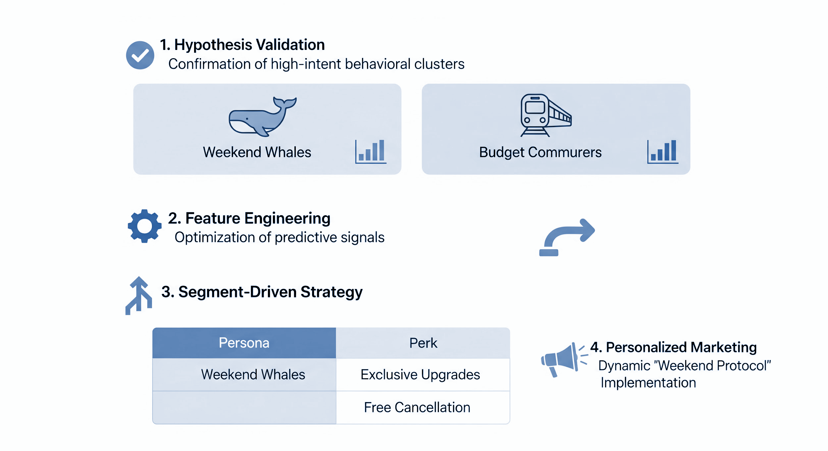
Key Takeaways
Notes:
Option 1 (End-to-End Pipeline - Süreç Bütünlüğü): "The framework illustrates a comprehensive data-to-value pipeline: converting the Hypothesis Validation of behavioral clusters directly into a Segment-Driven Strategy, where optimized predictive signals fuel the execution of the dynamic 'Weekend Protocol'."
Option 2 (Operational Focus - Uygulama Odaklı): "This workflow successfully operationalizes data science by translating abstract behavioral clusters (Weekend Whales) into tangible commercial actions, ensuring that every Feature Engineering effort culminates in a specific, targeted Personalized Marketing output."
Option 3 (Short & Punchy - Kısa Özet): "The process bridges the gap between Analytics and Execution: We validate high-intent clusters to deploy a precision-engineered 'Weekend Protocol', ensuring the right persona receives the right perk."

Slide 18

Thank You
Questions?
Hande Gabrali-Knobloch | MasterSchool | May 2025

Slide 19
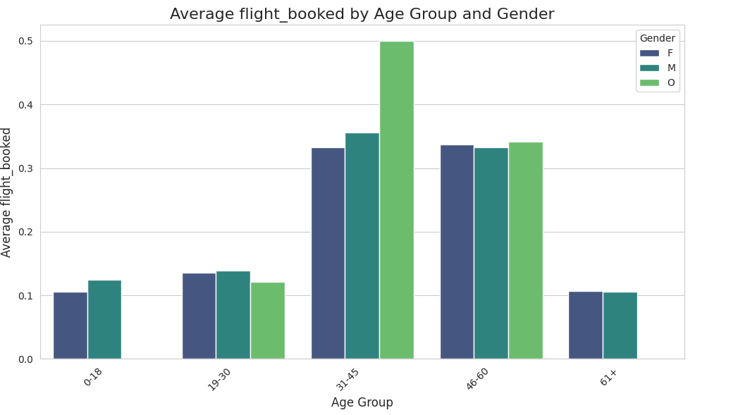
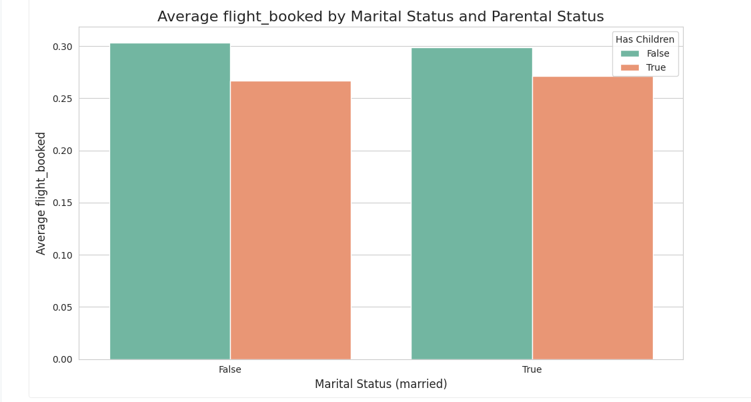
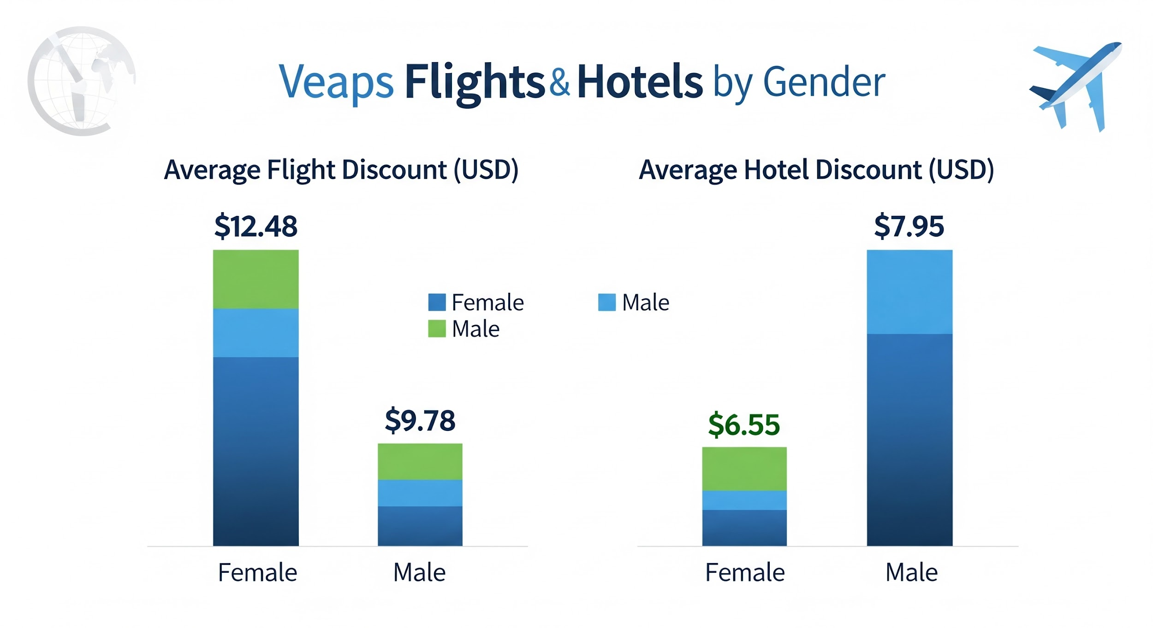
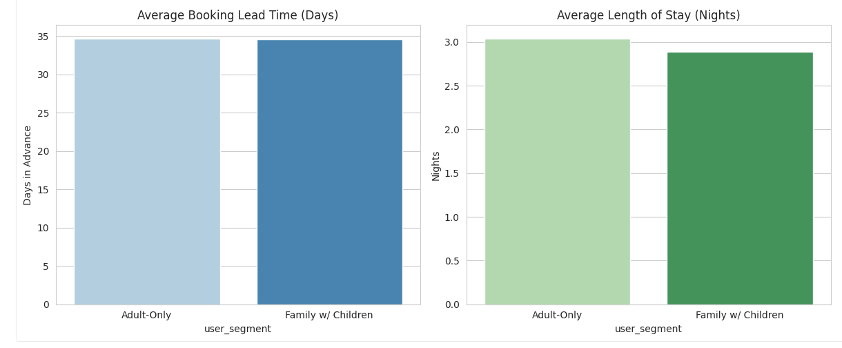

Slide 20
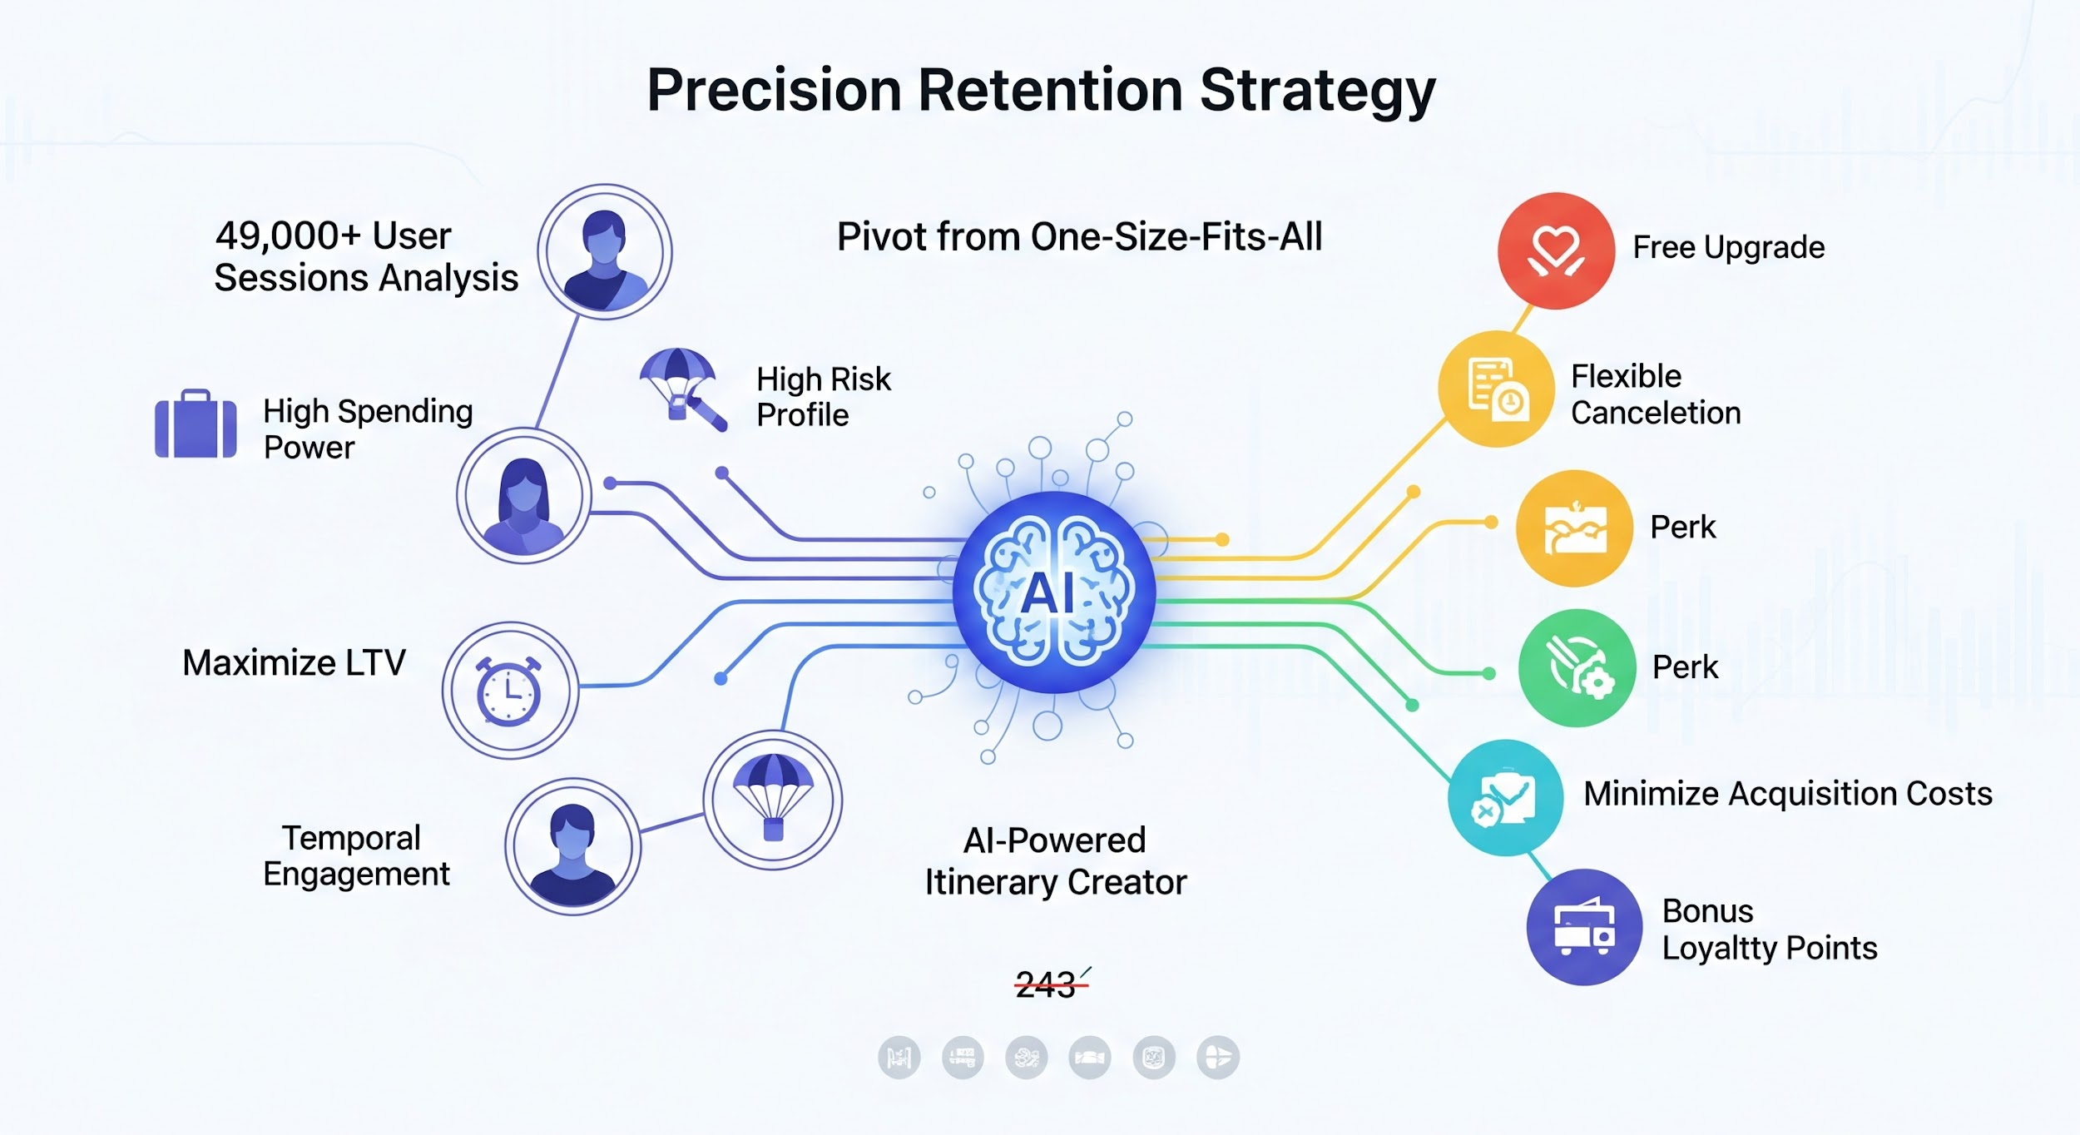

ML-Based Customer Segmentation for Optimal Perks

